Slide 1

Machine Learning Loan Prediction Model
Damien Crim, Griffin Racey, Andrew Voortman, Luke Payne, Amanda Baynard

Slide 2



Agenda
Data Preprocessing
Data Comparisons
Machine Learning Models
Predictions

Slide 3




Introduction
Our goal is to predict if a loan applicant will be approved or not. In order to achieve this, we came up with a machine learning model that will take the data we found and predict whether or not the applicants will be approved.

Slide 4

Data Pre-Processing
Using numpy, pandas, matplotlib and pathlib we removed columns, eliminated certain Null fields and updated to numerical values for more balanced processing.

Slide 5
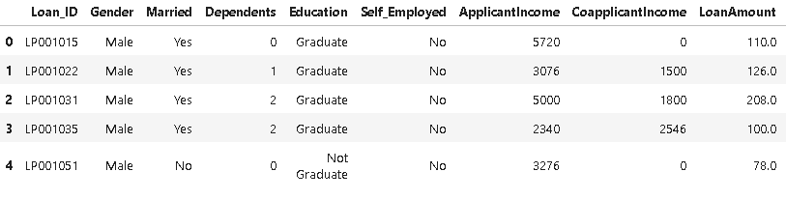
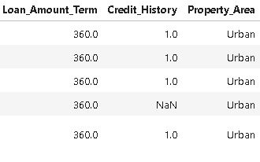
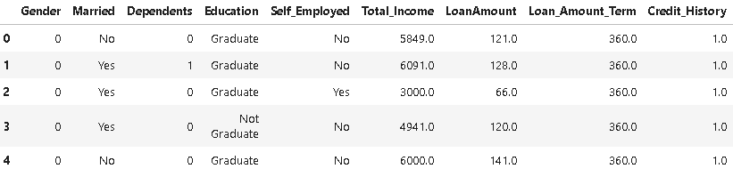
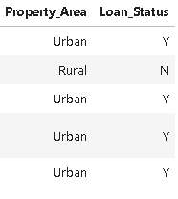
Original Column Layout
Revised Column Layout

Slide 6
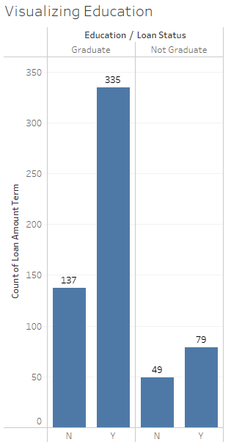
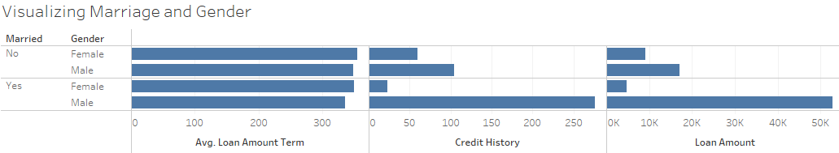
Data Comparisons Marriage and Gender
Education vs Loan Term

Slide 7
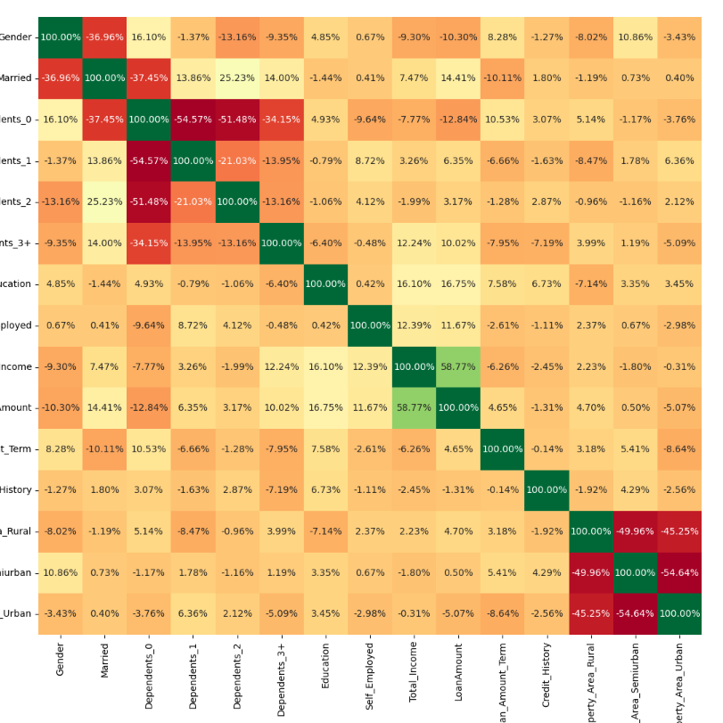
Correlation of different features

Slide 8




Machine Learning Models
Name
Name
Name
Name
Title
Title
Title
Title

Slide 9
Predictions
Title
To start a presentation, go to the Slide Show tab, and select From Beginning.
Title
To display Presenter view, in Slide Show view, on the control bar at the bottom left select the three dots, and then Show Presenter View.
Title
During your presentation, the speaker notes are visible on your monitor, but aren't visible to the audience.
Title
Title
If you don’t see the Notes pane or it is completely minimized, click Notes on the task bar across the bottom of the PowerPoint window.
The Notes pane is a box that appears below each slide. Tap it to add notes.

Slide 10

Summary
With PowerPoint, you can create presentations and share your work with others, wherever they are. Type the text you want here to get started. You can also add images, art, and videos on this template. Save to OneDrive and access your presentations from your computer, tablet, or phone.

Slide 11


Thank You

